Slide 1


2021
Netcoreconf
Data Storytelling with Power BI
Francisco Cruzado Perni
Development Architect @ AnalyticAlways
Associate Professor @ IE University
09/10/2021
@ocoloco

Slide 2



Slide 3
Agenda
01. Introduction.
02. Didn’t you talk last session about Data Storytelling?
03. Data Visualization in Five Steps Revisited.
04. Narrative structure.
05. Build a story with Power BI.
06. Data, tell me a story before going to bed.

Slide 4
Data Storytelling with Power BI
01. Introduction.
02. Didn’t you talk last session about Data Storytelling?
03. Data Visualization in Five Steps Revisited.
04. Narrative structure.
05. Build a story with Power BI.
06. Data, tell me a story before going to bed.

Slide 5
01. Introduction
What are we going to talk about?
Using Power BI to visualize data.
Storytelling with data.
What are NOT we going to talk about? (today …)
Organizing and Exploring data.
Data handling.
Advance Power BI.

Slide 6



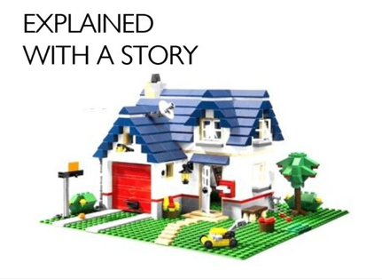

01. Introduction - Working with Data
Extracted from https://twitter.com/rskudesia/status/1431275057863561223?s=20

Slide 7
Data Storytelling with Power BI
01. Introduction.
02. Didn’t you talk last session about Data Storytelling?
03. Data Visualization in Five Steps Revisited.
04. Narrative structure.
05. Build a story with Power BI.
06. Data, tell me a story before going to bed.

Slide 8
02. Didn’t you talk last session about Data Storytelling?
Last session we focused on
Data Visualization in general.
Enhancing visualizations using Power Bi.
But I couldn’t talk about
Creating different layouts for the same visualization.
Narrative structure.
Storytelling with Data.

Slide 9
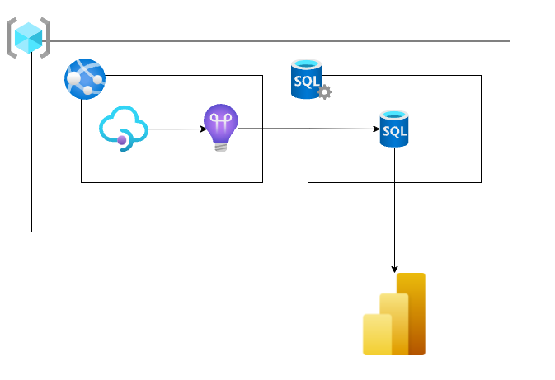
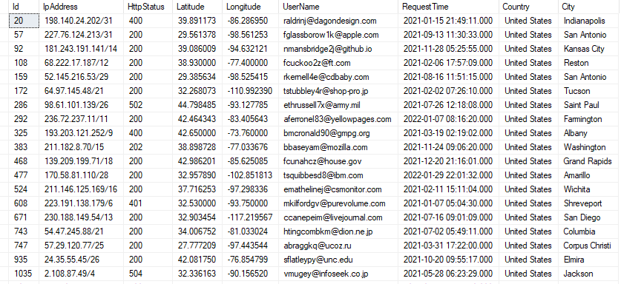
02 - Where we left - Analyzing our website traffic with Power BI

Slide 10
Demo 1: Initial visual elements
Demo!

Slide 11
Data Storytelling with Power BI
01. Introduction.
02. Didn’t you talk last session about Data Storytelling?
03. Data Visualization in Five Steps Revisited.
04. Narrative structure.
05. Build a story with Power BI.
06. Data, tell me a story before going to bed.

Slide 12
03. Data Visualization in Five Steps
Context
Visual Display
Declutter
Focus attention
Narrative structure

Slide 13

03. Data Visualization in Five Steps - Context
Who
Your audience
You
What
Action
Mechanism
Tone
How
Storyboarding

Slide 14
Demo 2: Creating different layouts
Demo!

Slide 15
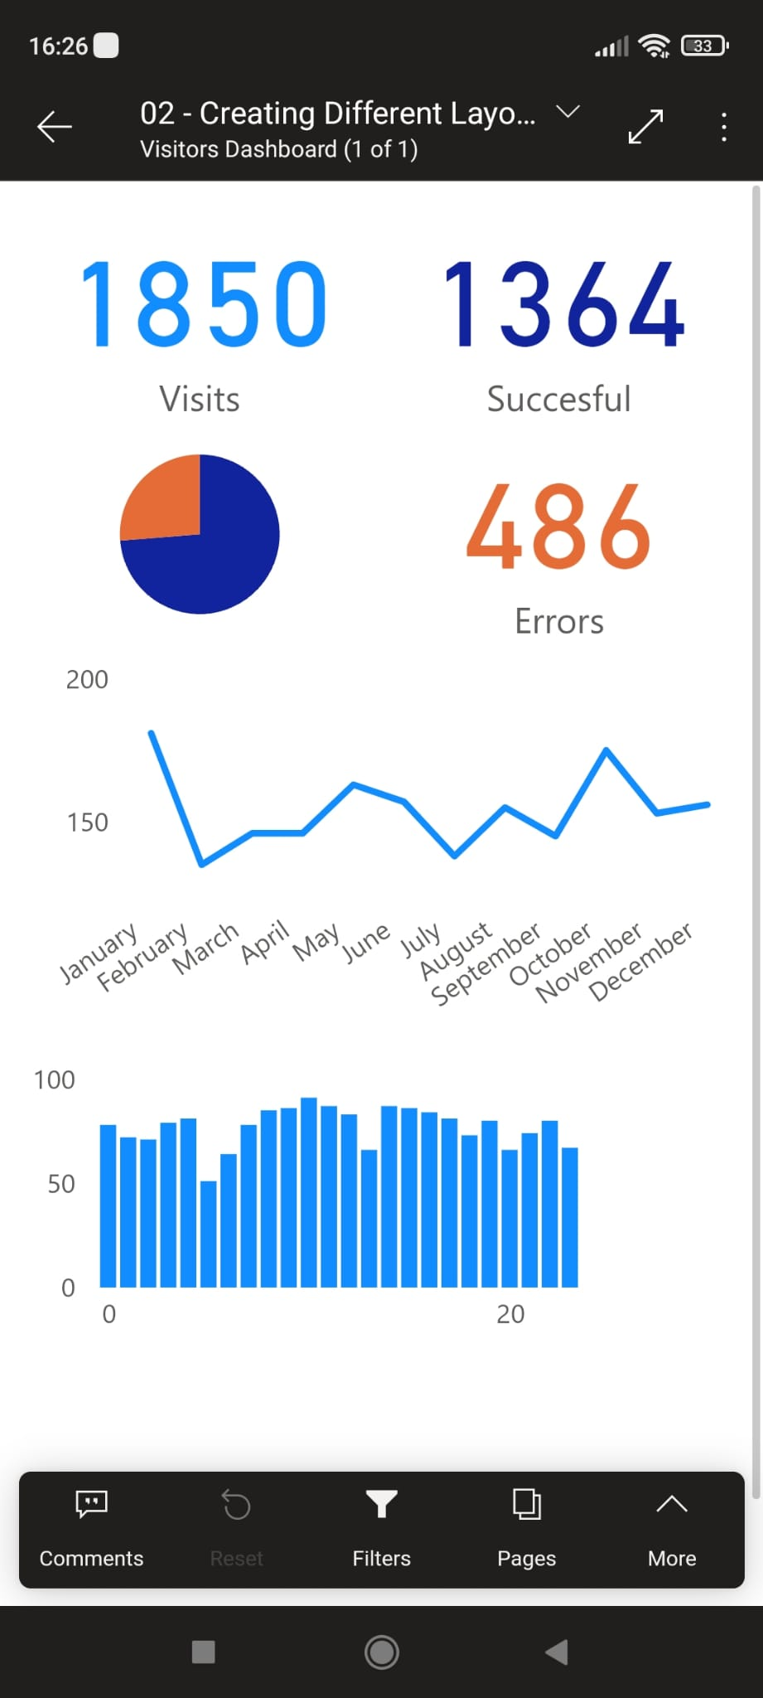
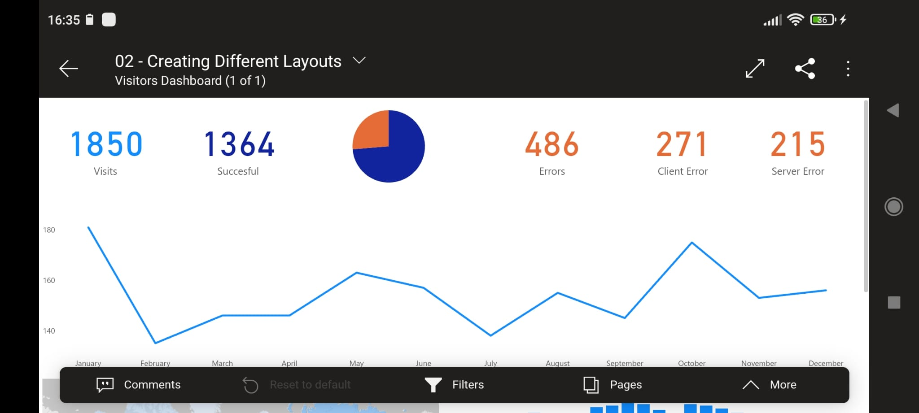
Demo 2: Creating different layouts

Slide 16
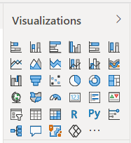
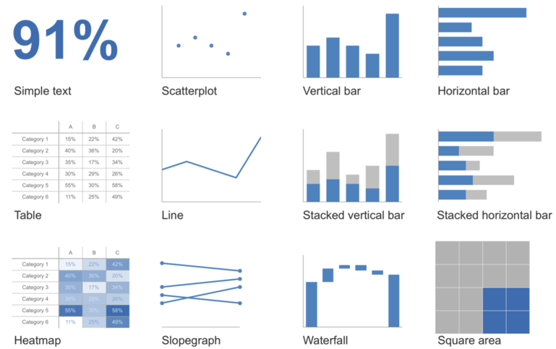
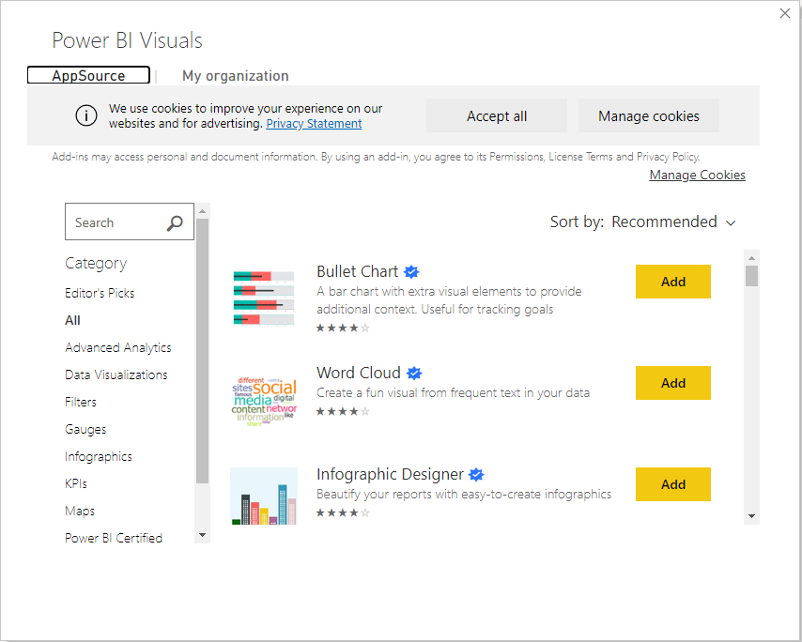
03. Data Visualization in Five Steps - Visual Display
Source: Nussbaumer Knaflic, Cole. Storytelling with data: a data visualization guide for business professionals (Wiley 2015).

Slide 17

03. Data Visualization in Five Steps - Declutter
Cognitive load
Reduce the effort
Clutter
Reduce the noise

Slide 18

03. Data Visualization in Five Steps - Focus attention
Pre-attentive attributes
Color
Form
Size
Position

Slide 19
Data Storytelling with Power BI
01. Introduction.
02. Didn’t you talk last session about Data Storytelling?
03. Data Visualization in Five Steps Revisited.
04. Narrative structure.
05. Build a story with Power BI.
06. Data, tell me a story before going to bed.

Slide 20

04. Narrative structure
Constructing the story
Beginning
Middle
End

Slide 21

04. Narrative structure - Beginning
The setting.
The main character.
The imbalance.
The balance.
The solution.

Slide 22

04. Narrative structure – Middle
Convince the audience of the need of action.
Why should they accept our solution?
Keep your audience as the main focus.
Headline technique.

Slide 23

04. Narrative structure – End
Call to action!
The end is the beginning is the end.
Recap

Slide 24
Data Storytelling with Power BI
01. Introduction.
02. Didn’t you talk last session about Data Storytelling?
03. Data Visualization in Five Steps Revisited.
04. Narrative structure.
05. Build a story with Power BI.
06. Data, tell me a story before going to bed.

Slide 25
05. Build a story with Power BI
We can ( and must!) use the same visualization to highlight different points.
Keep in mind the way that your story is going to be told.
Introduce plain text when needed.
Declutter and highlight.
Use pages as story points.
Use page titles as story point legend.

Slide 26
Demo 3: Storytelling with Data
Demo!

Slide 27
Data Storytelling with Power BI
01. Introduction.
02. Didn’t you talk last session about Data Storytelling?
03. Data Visualization in Five Steps Revisited.
04. Narrative structure.
05. Build a story with Power BI.
06. Data, tell me a story before going to bed.

Slide 28
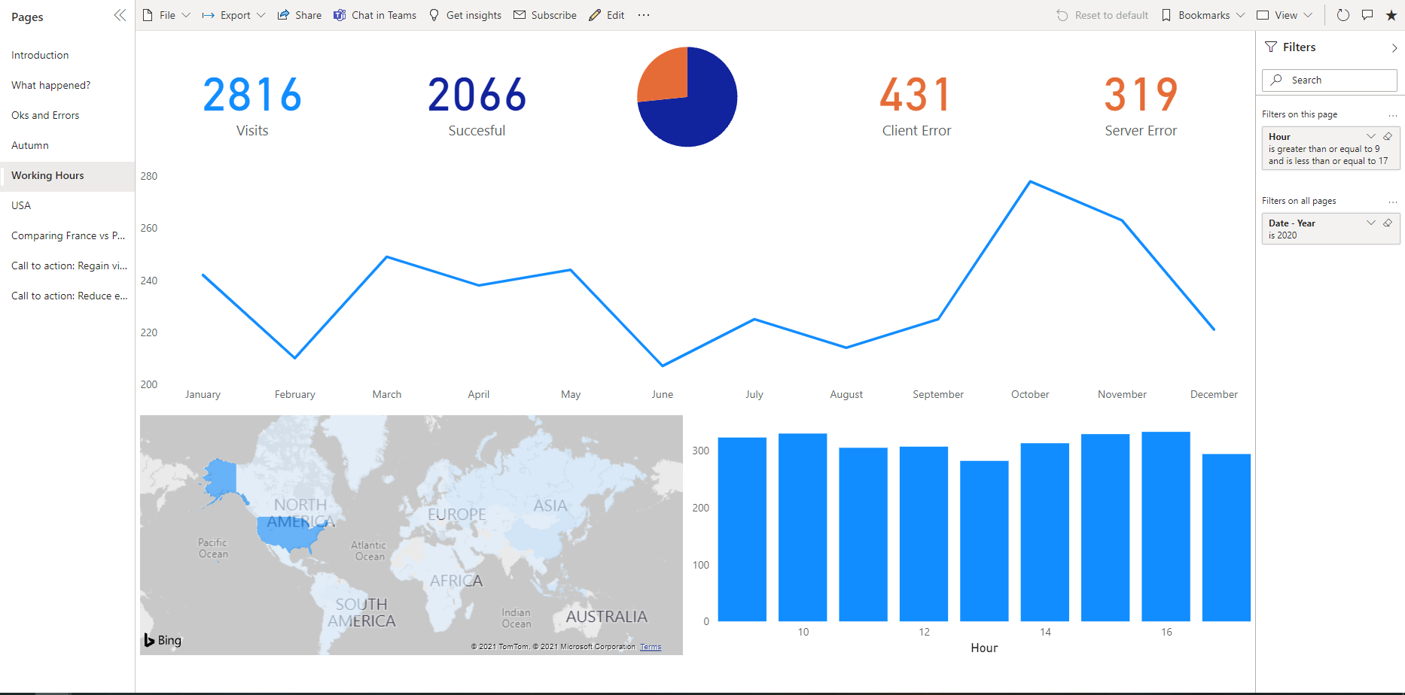
06. Data, tell me a story before going to bed

Slide 29
Extra – Resources
Materials available in github:
https://github.com/fcperni/DataStorytellingWithPowerBI
Materials from previous sessions and other projects:
https://fcperni.github.io/fcperni/

Slide 30
Extra – Bibliography & Recommended Readings
Storytelling with Data: A Data Visualization Guide for Business Professionals
http://www.storytellingwithdata.com
Knaflic, Cole Nussbaumer. Wiley (2015).
Design is Storytelling
Lupton, Ellen. Cooper Hewitt (2017)

Slide 31
Q & A
Ask me!

Slide 33
More information:
info@netcoreconf.com
@Netcoreconf
Visit on:
netcoreconf.com
Thanks

